Slide 1

EasyReg - MS2
Group-9
Ana Loureiro - 104063
Filipe Oliveira - 114640
Gonçalo Monteiro - 107758
Miguel Pinto - 108481
Miguel Francisco - 108304

Slide 2
CONTEXT
Multiple Compliance Requirements
Need for an Integrated Solution
Manual Processes and Risks
Organizations need to work across multiple frameworks, each with its own compliance requirements, resulting in significant complexity in managing the process.
There is a demand for a centralized platform that automates the tracking and management of requirements, optimizing workflows and ensuring security.
Manual evidence collection and audit execution increase the risk of inconsistencies and errors, while also requiring significant operational effort.
1

Slide 3

Non-Functional Requirements
Adaptability
The platform must be accessible via a web browser and optimized for mobile devices.
Security
The platform must comply with OWASP security standards to prevent attacks like SQL Injection.
Maintainability
The system should be easy to maintain and update.
Usability
The system should be easy to use and intuitive.
Storage
Backup policies should ensure data recovery in case of failure.
2

Slide 4

Functional Requirements
Authentication, Authorization and Security
Audits Management
→ Login/Logout of users with safe authentication
→ Real time tracking of audits
→ Management of permissions and access levels associated to roles (RBAC)
→ Association of audits to specific standards
→ Secure document access based on user privileges
→ Creating, editing and removing audits
Evidences Management
Compliance
→ Centralized repository for the storage of evidences
→ Automatic generation of reports
→ Assignment of tasks to contributors for evidence submission
→ Metrics dashboard for compliance progress tracking
→ Upload of evidence in different formats (png, jpge, pdf).
→ Version control for evidences and track of modifications
→ Filters for the visualization of specific data
3

Slide 5
User Profiles
Administrator
Company Owner
Contributor
Configures system settings and manages user roles.
Manages overall company settings and user access.
Uploads evidence and responds to task requests.
Internal Auditor
External Auditor
Reviews evidence and creates reports.
Conducts independent audits and verifies compliance.
4

Slide 6


User Stories
As a Contributor, I want to upload evidence so that I can provide compliance documentation. Given I am on the evidence submission form When I fill in the mandatory message field Then I should be able to submit the evidence.
5

Slide 7

User Stories
As a Contributor, I want to view the status of submitted evidence so that I can track the progress of compliance submissions.
As a Company Owner, I want to create a tenant so that my organization has a designated compliance workspace.
6

Slide 8

User Stories
As a Company Owner, I want to assign roles to users so that I can control access and responsibilities.
As an Internal Auditor, I want to evaluate evidence submissions so that I can determine compliance status.
7

Slide 9

User Stories
As an External Auditor, I want to review Internal Auditors' reports so that I can validate their assessment and detect inconsistencies.
As an Admin, I want to update or block users so that I can manage user access and ensure data security.
8

Slide 10
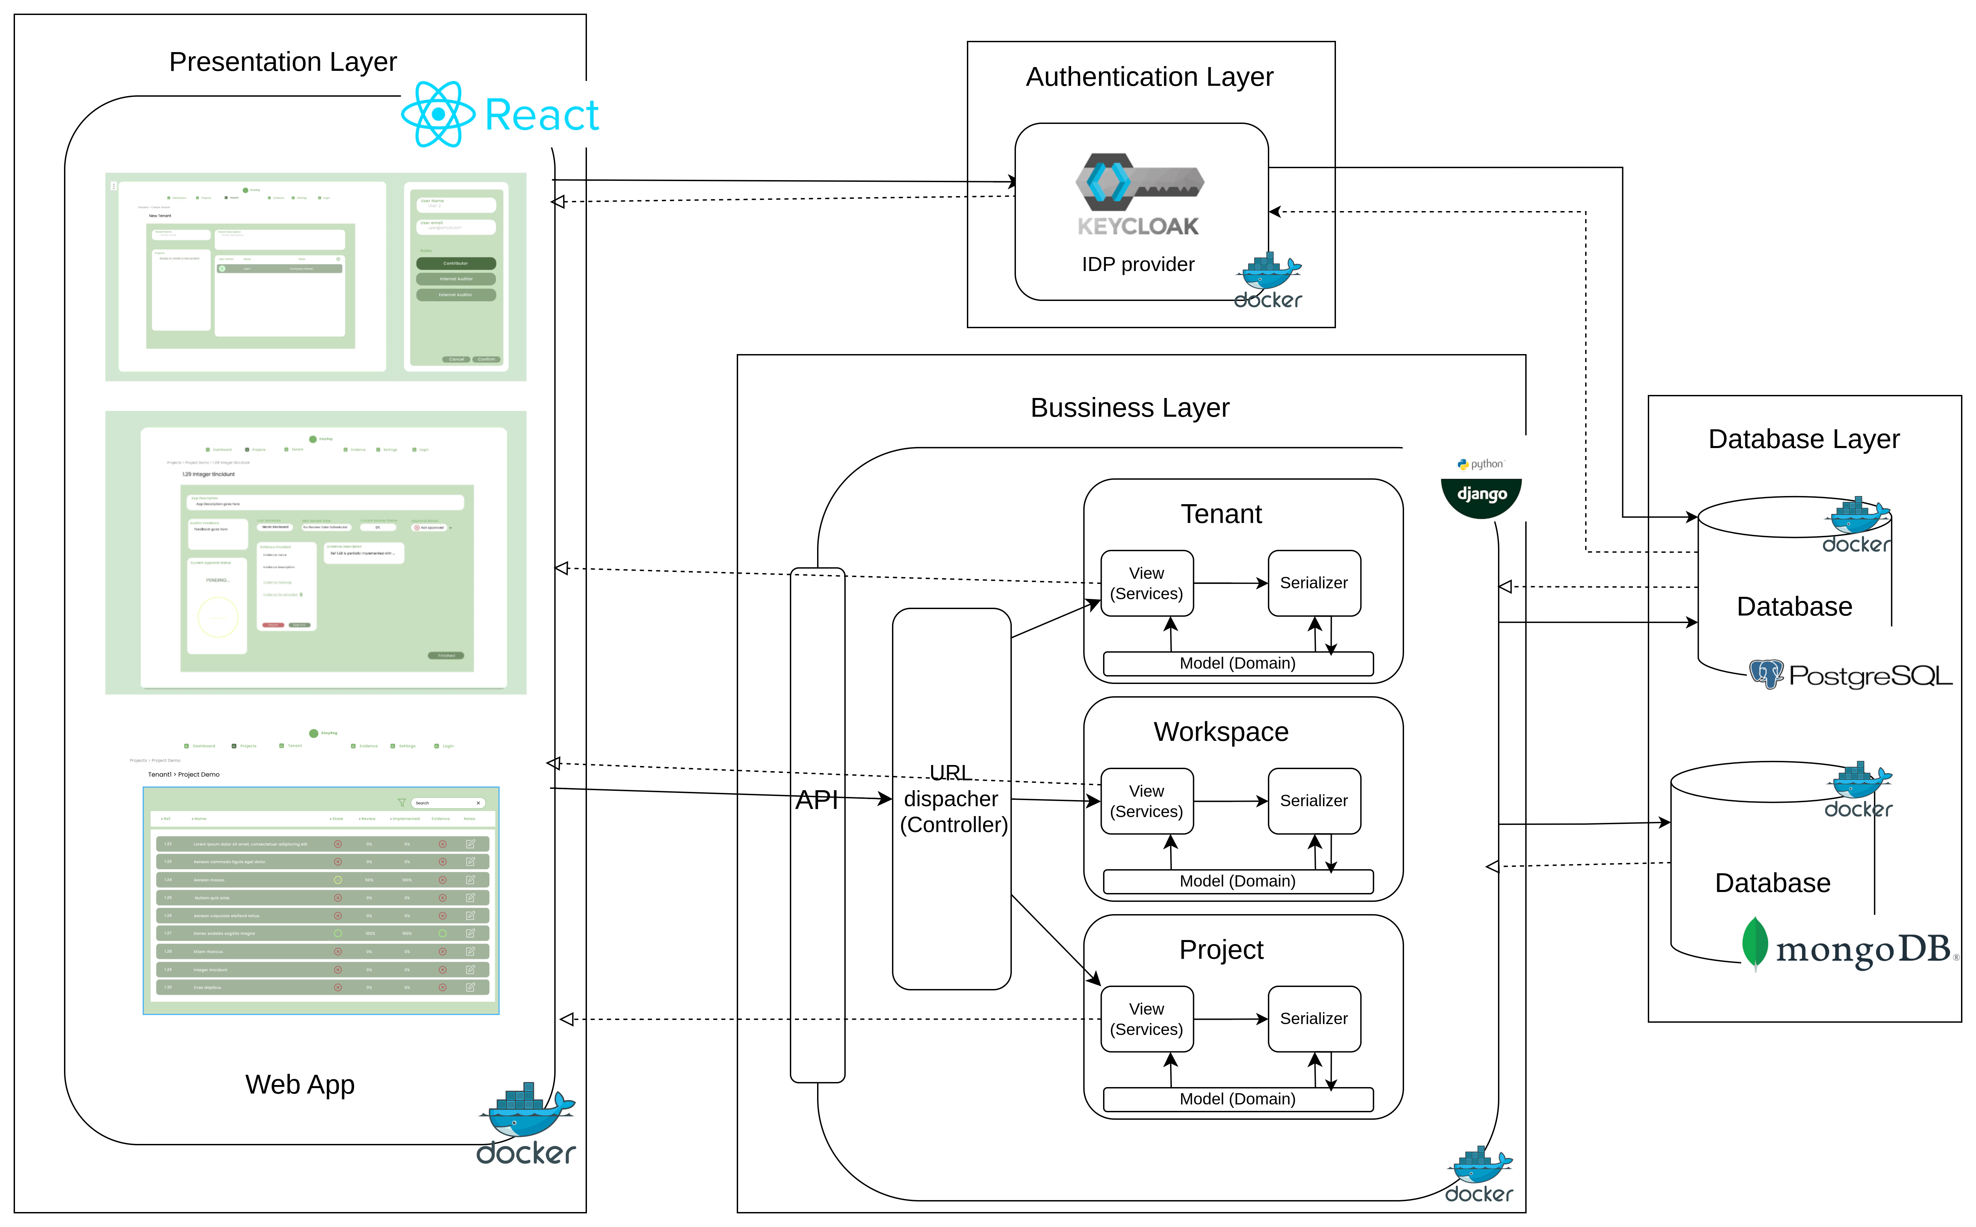
Architecture
9
5

Slide 11
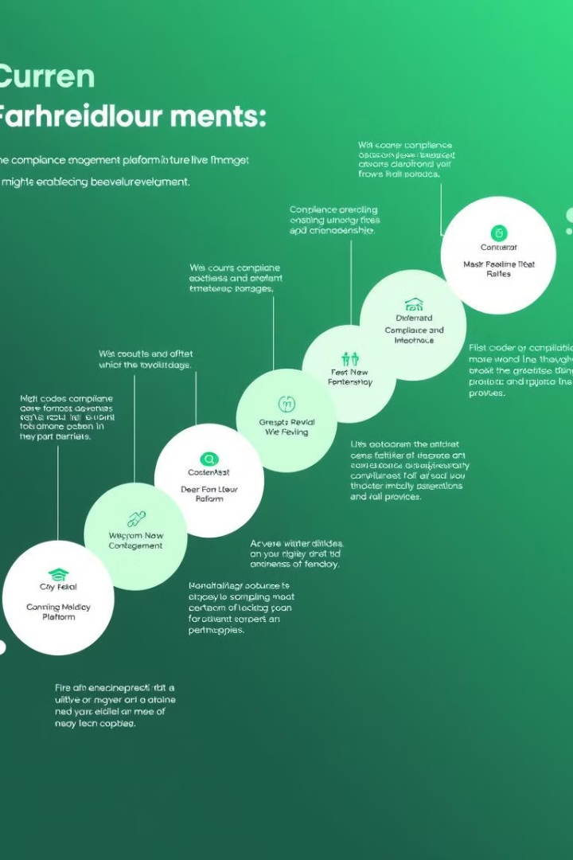


Next Steps- Implementation
Authentication
Database, Backend, Frontend
10

Slide 12
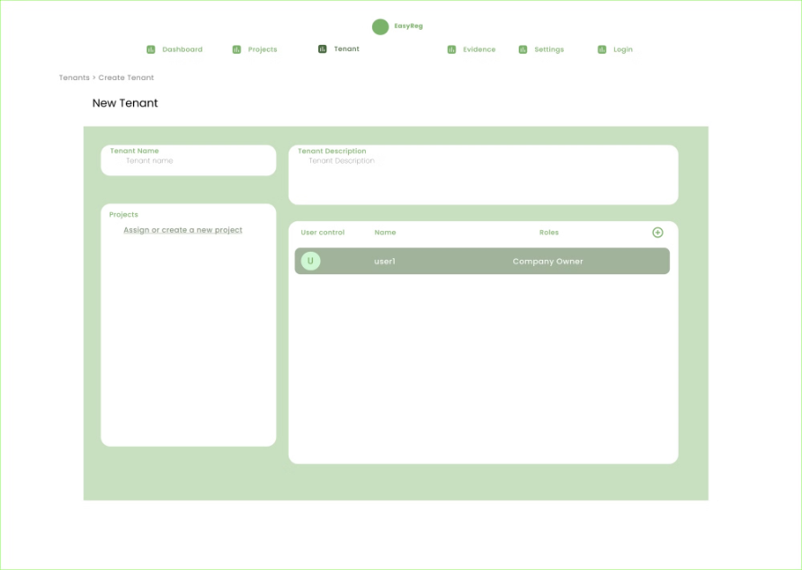
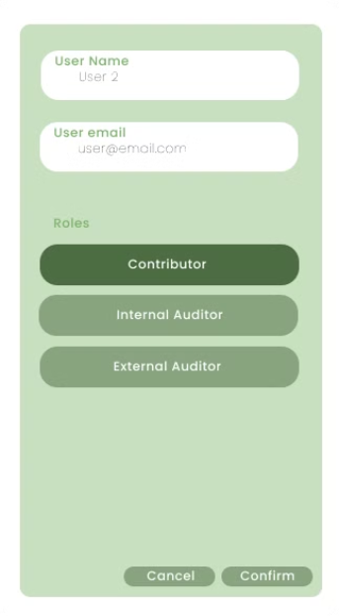
Mockups
Company owner
Create a tenant | Add a new user with roles
11

Slide 13
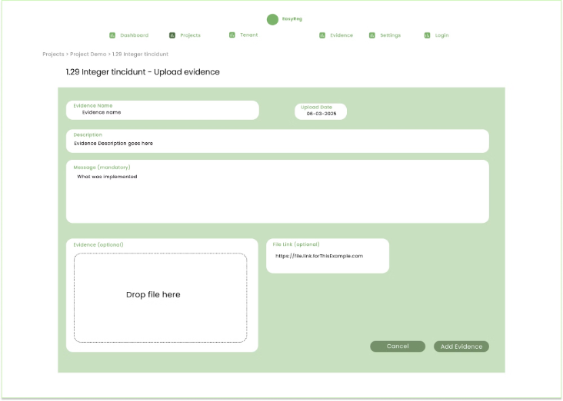
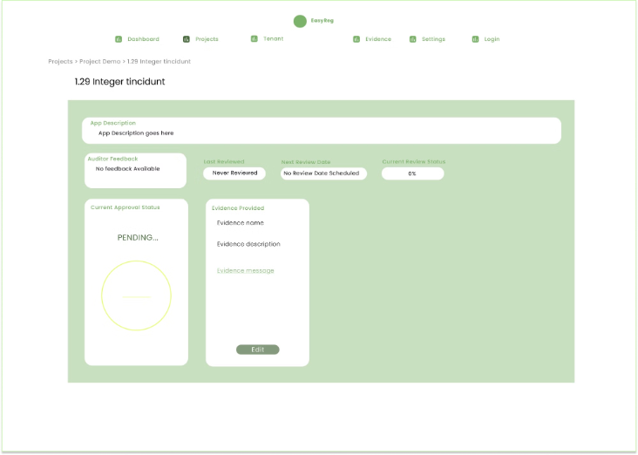
Mockups
Contributor
Upload evidence | Status of uploaded evidence
12

Slide 14
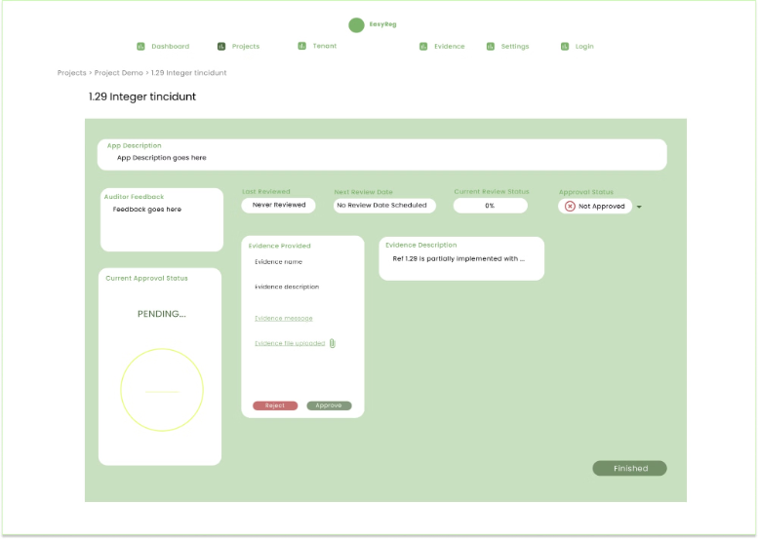
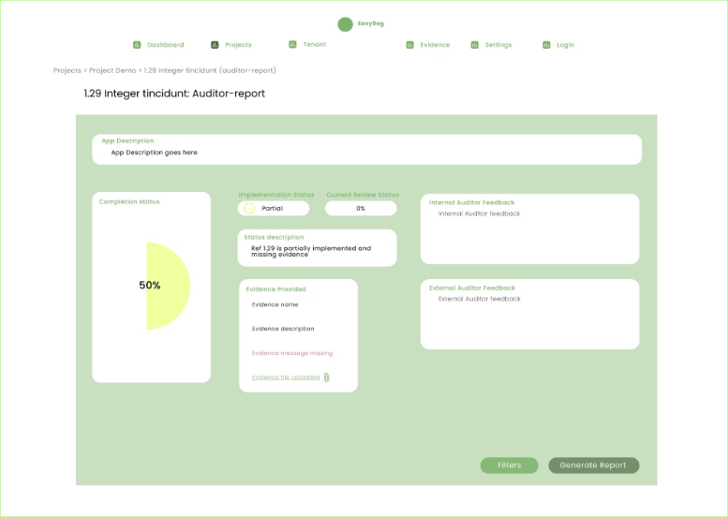
Mockups
Auditors
(IA) Evaluate evidence | (EA) Generate status report
13

Slide 15
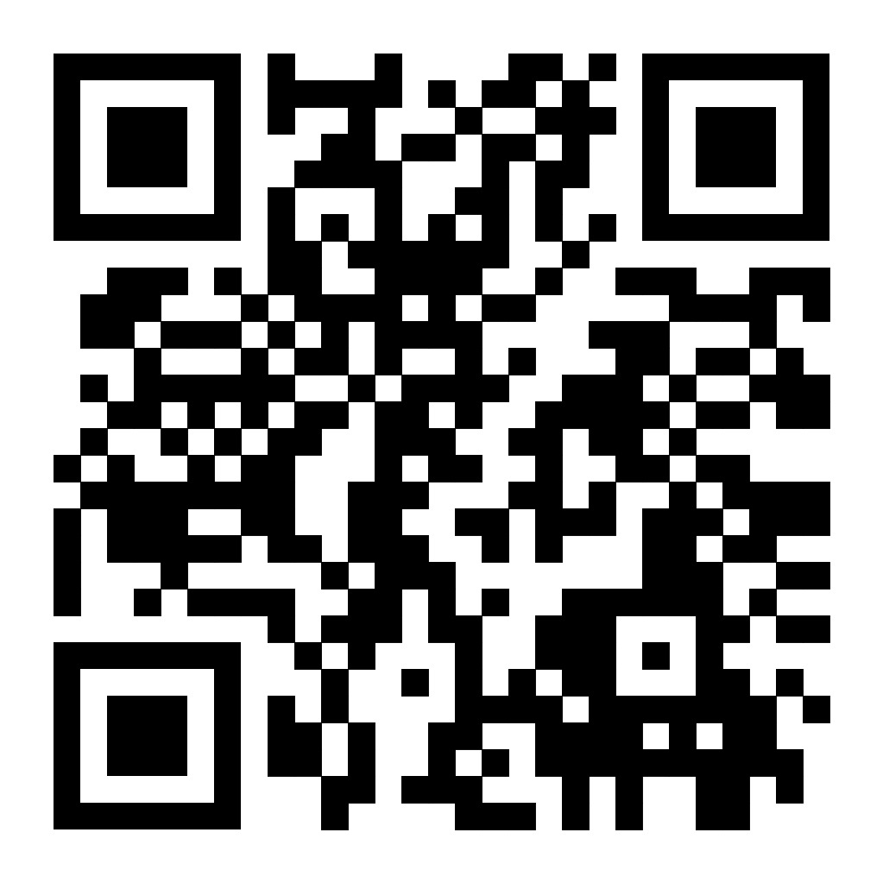
Microsite
If you want to know more about us, scan the code or click the link. Feel free to ask any questions.
https://easyregpi.github.io/micro-site/
14

